Slide 1
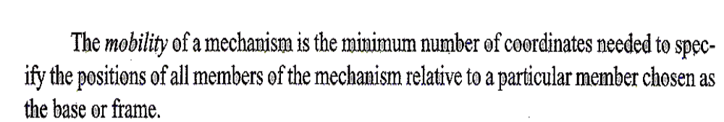
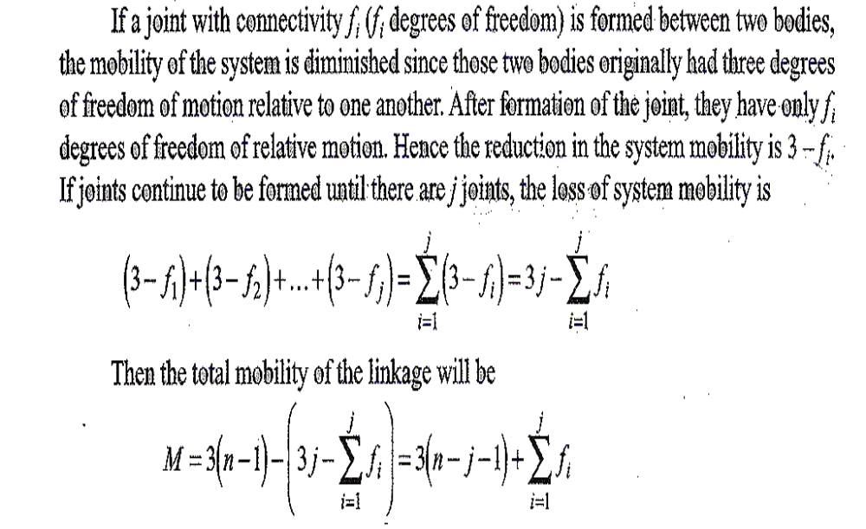
Mobility : Planar Mechanisms
Gruebler/Kutzbach criterion
In simple form (no higher pairs)
M= 3n-2j-3

Slide 2
Mobility for pin joints with multiple links
n links connected by one pin joint implies there are actually (n-1) joints. Imagine considering two links and joining them by a pin. Adding a 3rd link will require a 2nd pin joint, adding a 4th to this combination will mean a 3rd joint and so forth.

Slide 3
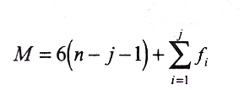
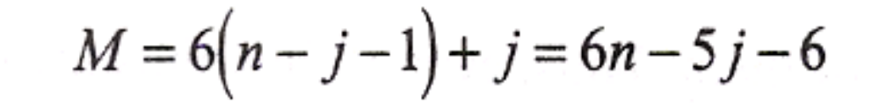
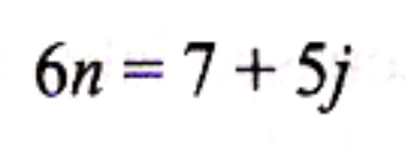
Mobility : Spatial
Kutzbach Criterion for spatial linkages
Mobility criterion for spatial linkages
with lower pair only
Minimum mobility criterion

Slide 4
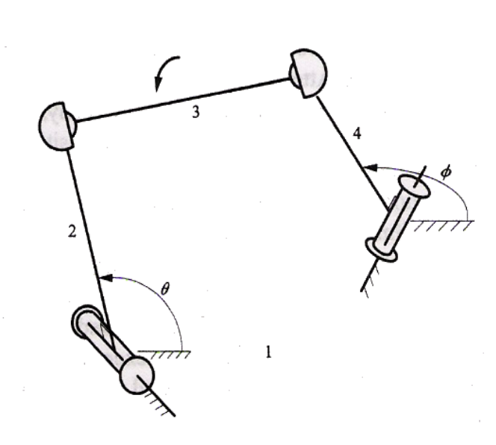
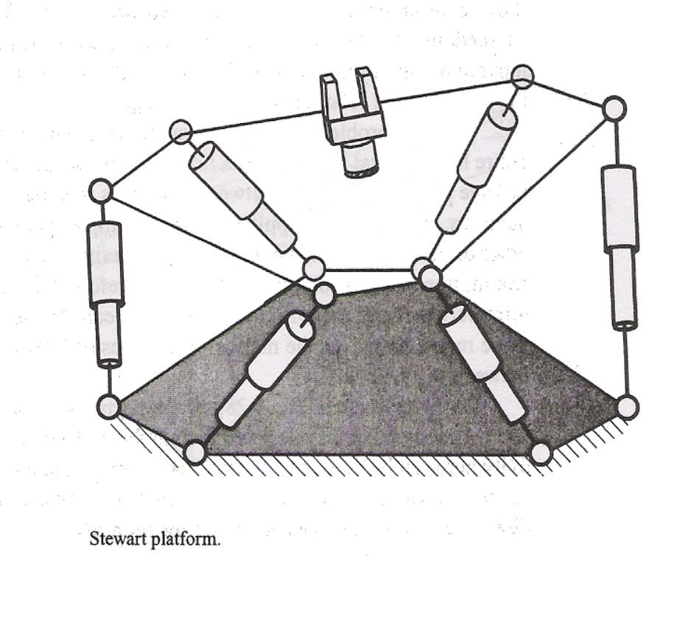
Examples of Idle degrees of freedom

Slide 5
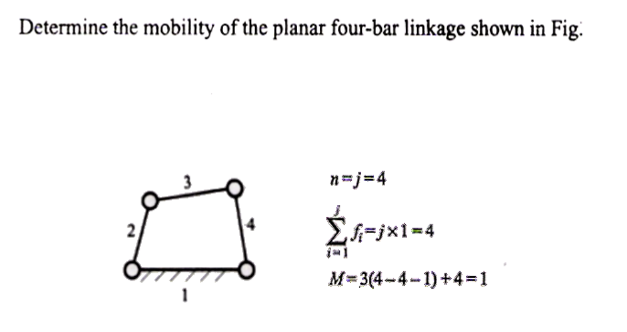
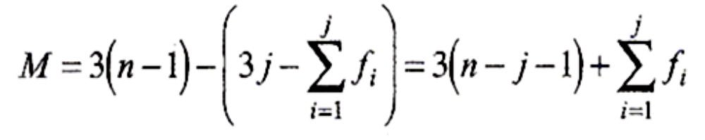
Solved problems 1

Slide 6
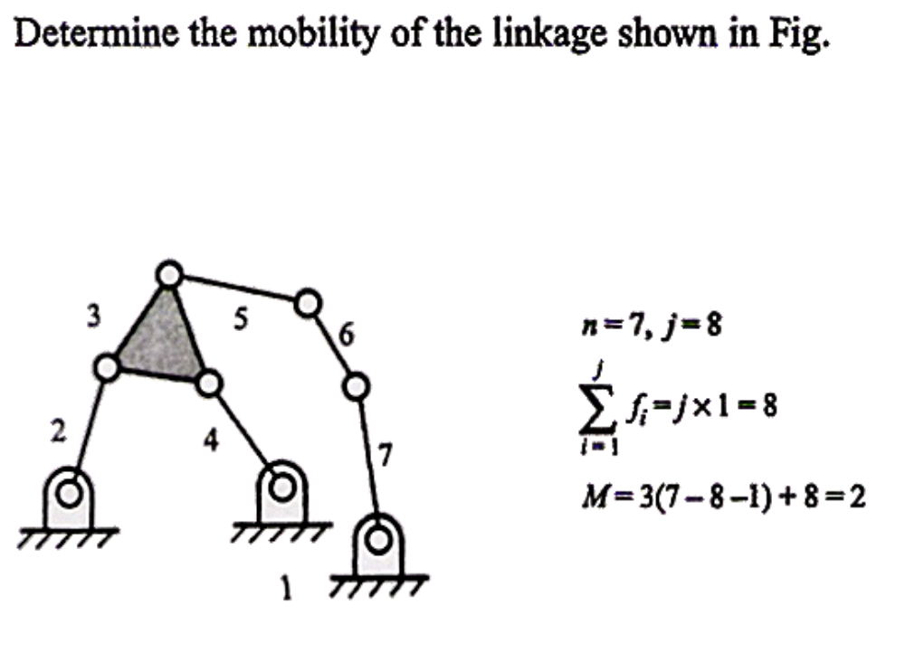
Solved problem 2

Slide 7
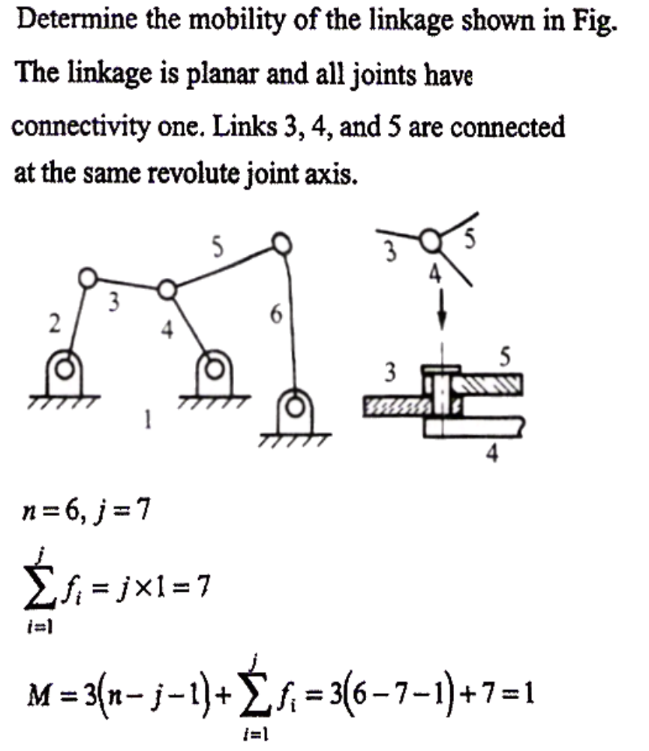
Solved problem 3

